Slide 1
Derivation Tree in TOC
Dr. Shinnu Jangra
Assistant Professor
Department of Artificial Intelligence and Machine Learning, Manipal University Jaipur, Rajasthan, India

Slide 2
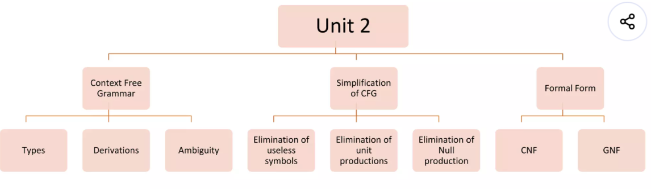

Slide 3
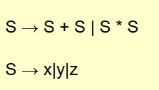
Derivation Tree in TOC
Deriving a string in the form of a tree from a CFG grammar is called a derivation tree in TOC. A Context-Free Grammar (CFG) generates strings by applying production rules. These strings can be represented in the form of a tree, which is called a derivation Tree.
Derivation tree is also known as a parse Tree, or syntax tree.
Derivation tree shows how a string is formed from the start symbol of a Context-Free Grammar (CFG) by applying production rules step-by-step.
Examples of Derivations
let explain some examples of derivations in TOC
Suppose the following Production rules of a Grammar (G)
and Input is (x * y + Z)

Slide 4
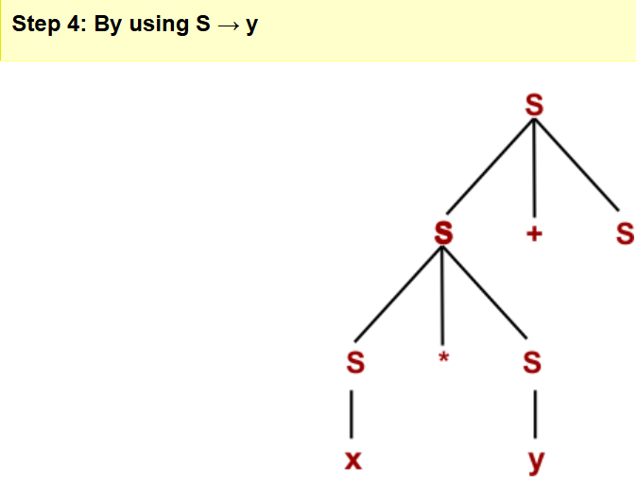
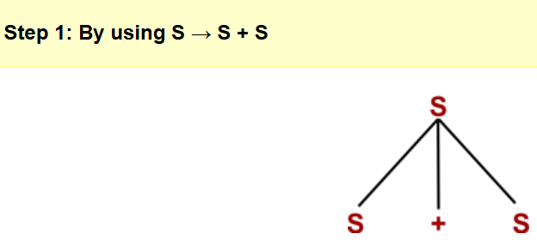
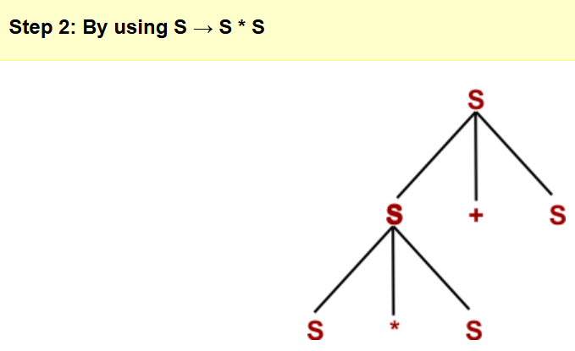
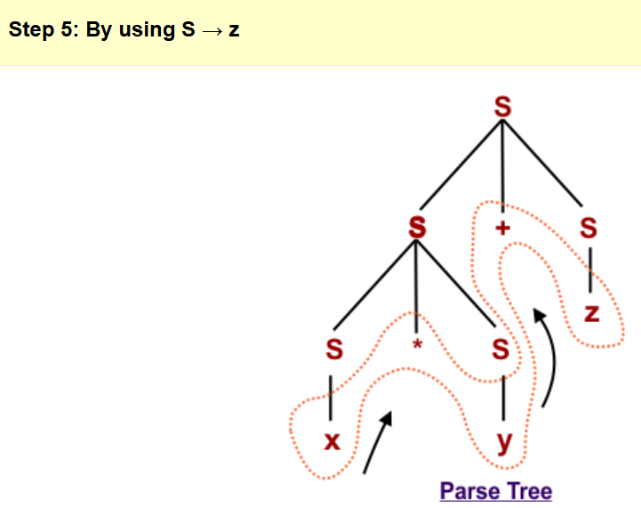
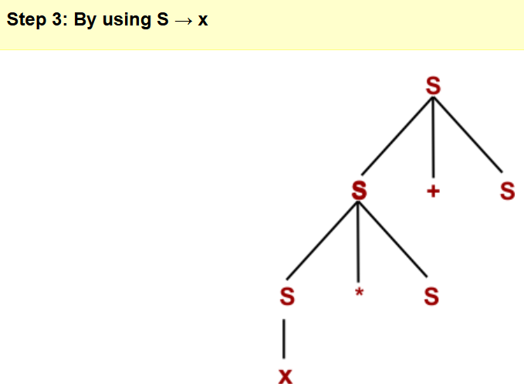
For Input is (x * y + Z)

Slide 5
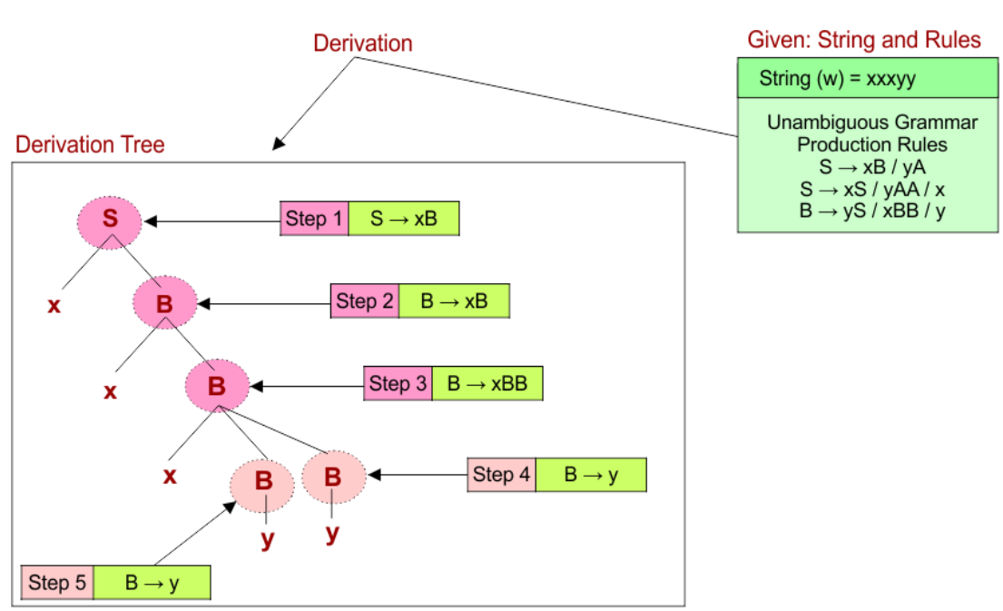
Example 02:
Grammar Production Rules are
S → xB / yA
S → xS / yAA / x
B → yS / xBB / y
Input string is “xxxyy“
How Derivation Works?
It is called a tree because:
Start with the start symbol (a non-terminal) at the top of the tree (root).
Apply production rules to expand non-terminals into other non-terminals or terminals, forming branches.
Repeat expansions until all branches end in terminal symbols (no non-terminals remain).
The leaf nodes (terminals), read from left to right, form the final generated string.

Slide 6
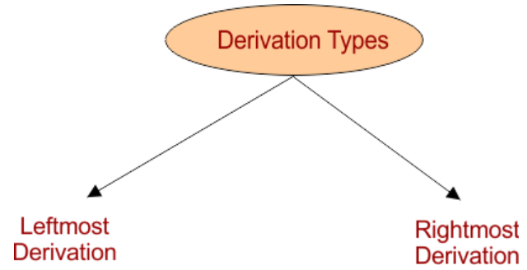
Need for Derivation
A derivation tree is helpful when a string and a grammar (set of production rules) are given, and we need to check whether the string can be generated by the grammar or not. The main goals of using derivations are given below
Shows how a string is formed step-by-step by applying grammar rules from the start symbol to terminals.
Helps compilers understand code structure by breaking programs into meaningful parts during parsing.
Identifies ambiguity, ambiguity means that if two different trees can be drawn for the same string, then the grammar is ambiguous.
Checks syntax correctness by ensuring the code follows the grammar rules of the language.
Types of Derivation
There are two main types of derivation trees

Slide 7
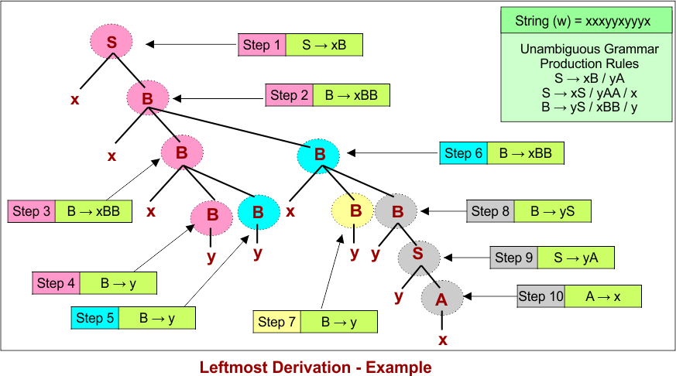
1. Leftmost Derivation Tree
In a leftmost derivation, at each step, the leftmost non-terminal in the current string is expanded first using a production rule.
This method is useful in top-down parsing techniques, like recursive descent parsers.
Here is descriptive diagram of the leftmost derivation tree

Slide 8
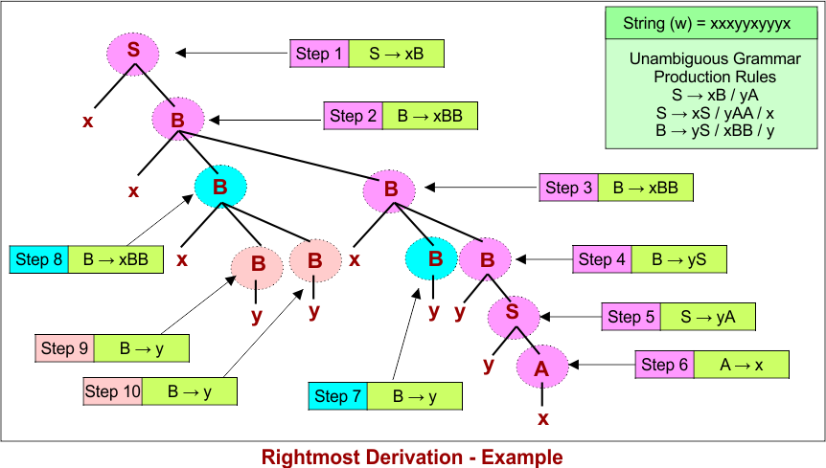
2. Rightmost Derivation Tree
In a rightmost derivation, at each step, the rightmost non-terminal in the current string is expanded first.
Rightmost derivations are commonly used in bottom-up parsing algorithms, such as shift-reduce parsers.
Here is discriptive diagram of rightmost derivation tree

Slide 9
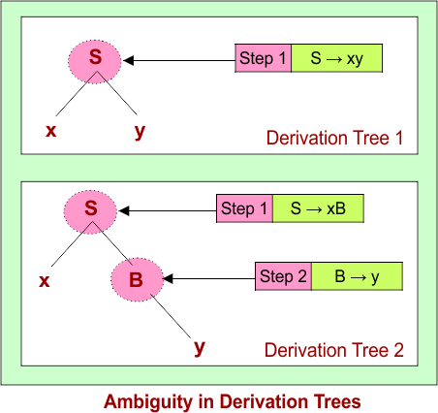
Ambiguity in Derivation Trees
A grammar is called ambiguous if there exists at least one string in the language that can be generated by two or more different derivation trees (or parse trees).
Example:
Production rules: S → xB | xy , A → AB | x , B → Ayy | y
Given string (W) to derive: xy.
Ambiguity means there are multiple ways to apply production rules to derive the same string, leading to different tree structures.
Ambiguous grammars can cause confusion in parsing, as the meaning or structure of the string is not uniquely defined, which is undesirable for programming languages.
Properties Of Derivation Tree
In the derivation tree
The root node of a parse tree represents the start symbol of the grammar.
Each leaf node corresponds to a terminal symbol, while each interior node represent a non-terminal symbol.
The structure of the parse tree remains unaffected by the order in which the production rules are applied during the derivations.

Slide 10
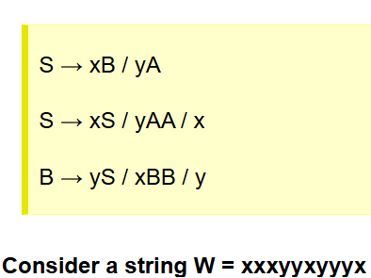
Leftmost and Rightmost Derivation Example
Consider the following production rules for the grammar (G)

Slide 11
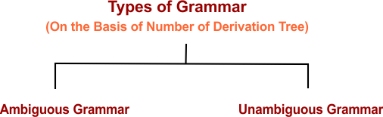
Ambiguity in Context-Free Grammar
Ambiguity in a context-free grammar occurs when a single string can be generated by the grammar in more than one way, resulting in multiple parse trees, leftmost derivations, or rightmost derivations. A context-free grammar is said to be ambiguous if at least one string in its language has two or more distinct derivation trees.
Note: We use a general approach to identify ambiguity in Context-free grammar as there is still no algorithm that checks it.
Based on the number of derivation trees in TOC, Ambiguity Grammar is classified into two terms. One is ambiguous grammar, and the other is Unambiguous grammar.

Slide 12
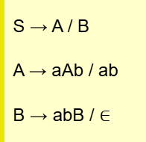
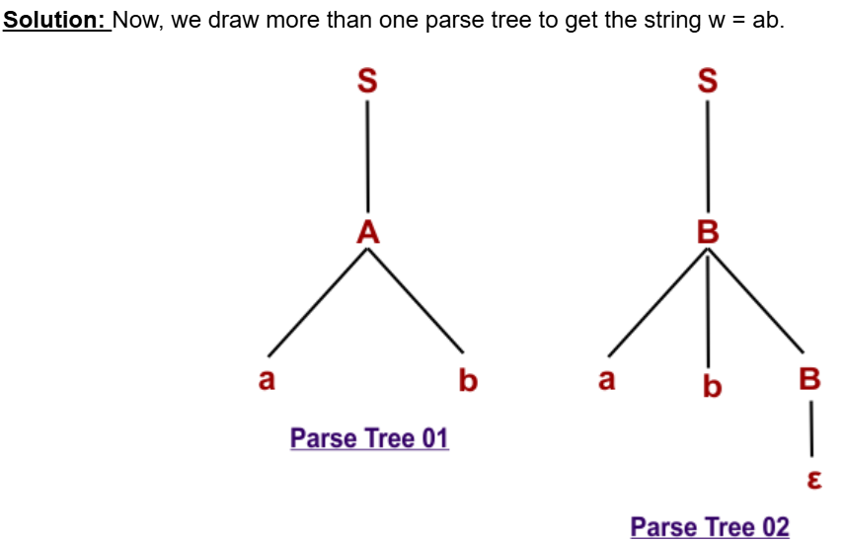
1. Ambiguous Grammar
A grammar is said to be ambiguous grammar if any string generated by it produces more than one.
Parse tree (syntax tree)
Or leftmost derivation
Or rightmost derivation
Examples of Ambiguous Grammar
Example 01: Check whether the following grammar is ambiguous or not for string w = ab
The original string (w =ab) can derived through two different parse trees. So, the given grammar is ambiguous.

Slide 13
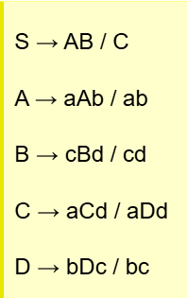
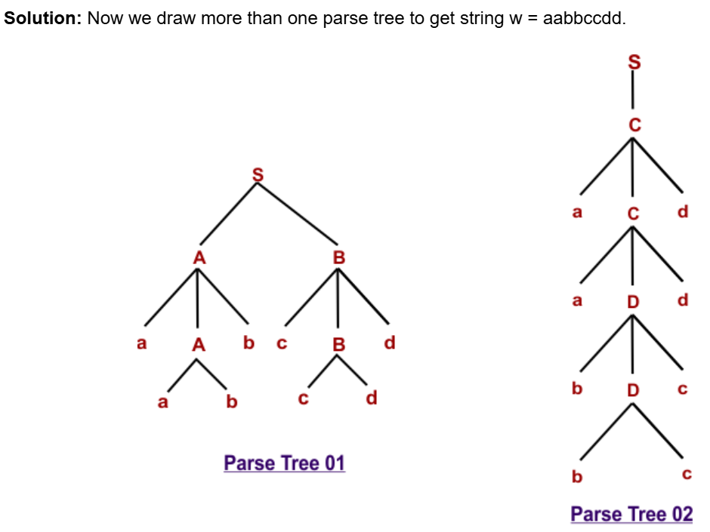
Example-02: Check whether the following grammar is ambiguous or not for string w = aabbccdd
The original string (w =aabbccdd) can derived through two different parse trees. So, the given grammar is ambiguous.

Slide 14
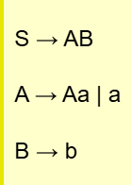
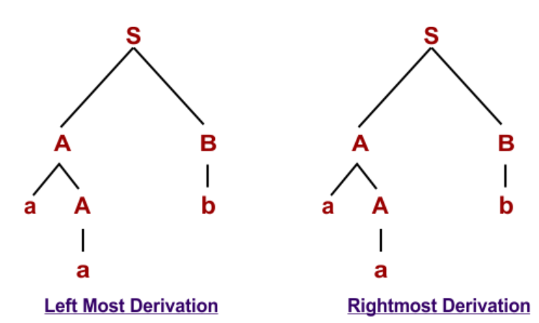
2. Unambiguous Grammar
A grammar is said to be unambiguous grammar if every string generated by it produces exactly one.
Parse tree
Or syntax tree
Or leftmost derivation
Or rightmost derivation
Note: So, If we try to derive more than one tree of unambiguous grammar, then all trees will be similar
Examples of Unambiguous Grammar
Example 01: For string “aab” the following grammar is unambiguous
Because all parse trees, syntax trees, and left or right derivations will be similar for the above grammar of string “aab.” So, the above grammar is unambiguous.

Slide 15
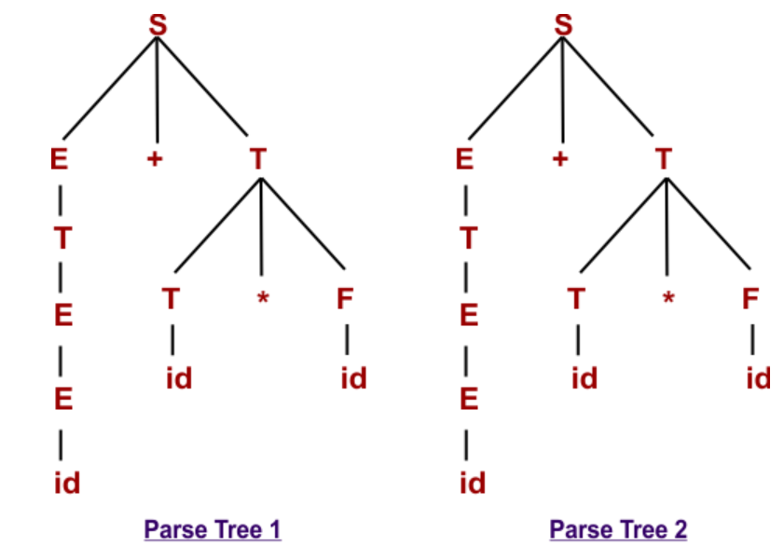
Example 02: For string “id+id*id,” the following grammar is unambiguous
E → E + T
E → T
T → T * F
T → F
F → id
Solution: Because all parse trees, syntax trees, and left or right derivations will be similar for the above string grammar “id+id*id.” As given below

Slide 16
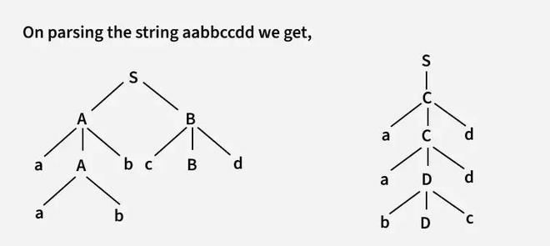
Q1. Consider the language L defined as:
L = { aⁿbⁿcᵐdᵐ : n ≥ 1, m ≥ 1 } ∪ { aⁿbᵐcᵐdⁿ : n ≥ 1, m ≥ 1 }
A grammar for this language could be:
S → AB | C
A → aAb | ab
B → cBd | cd
C → aCd | aDd
D → bDc | bc
Let’s see how the string aabbccdd can be parsed. This string has two possible leftmost derivations:
Q2. Following are some examples of ambiguous grammar:
S -> aS | Sa | ε
E-> E +E | E*E| id
A -> AA | (A) | a
S -> SS | AB
A -> Aa | a
B -> Bb | b

Slide 17
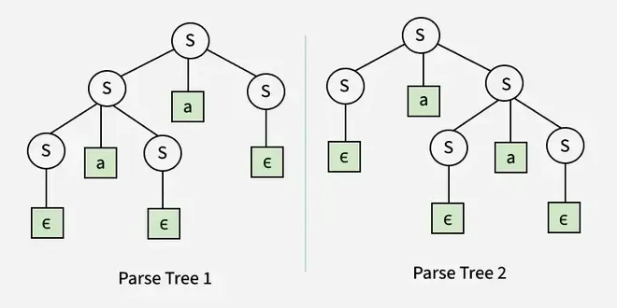
Q3: Example: S → SaS | ε

Slide 18
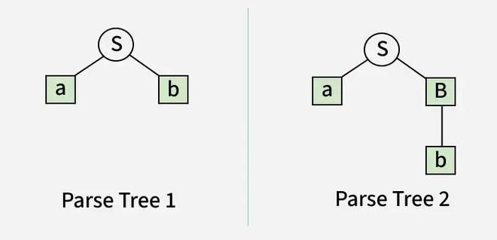
Q4: Example: S → aB | ab , A → AB | a , B → Abb | b

Slide 19
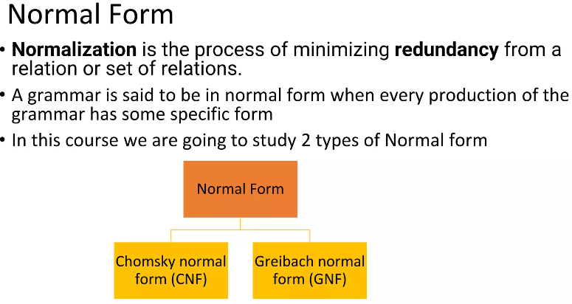
Removal of Ambiguity from CFG
Conversion from an ambiguous grammar into an unambiguous grammar is not always possible. Several methods are employed to eliminate ambiguity from the CFG. Some common methods are given below.
By fixing the grammar
By adding the precedence rules
By adding grouping rules
By using semantics

Slide 20
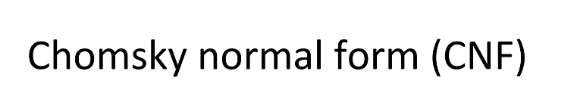
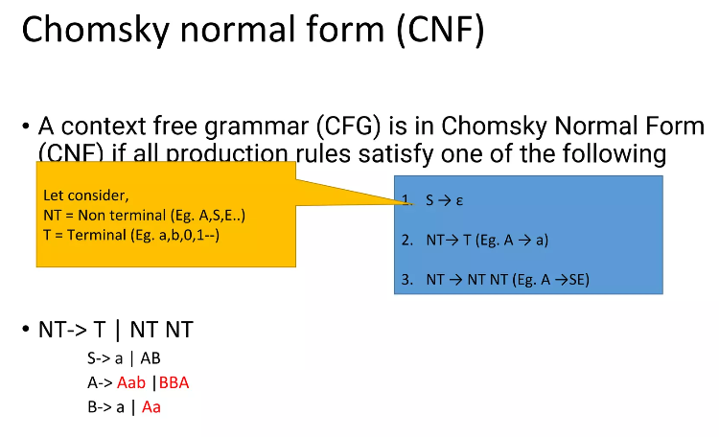
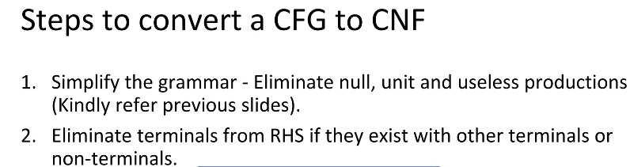
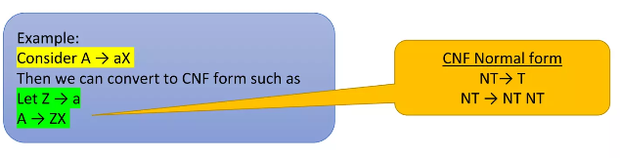

Slide 21
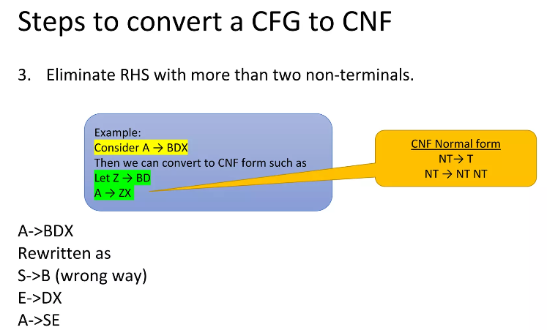
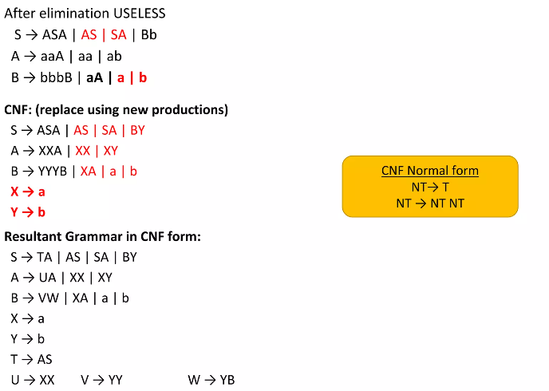
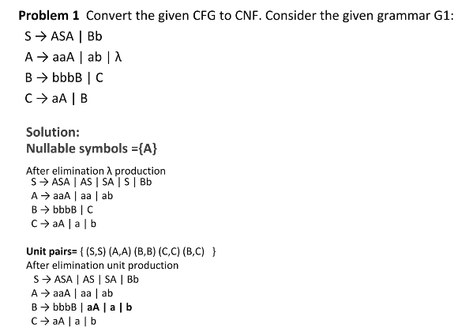

Slide 22
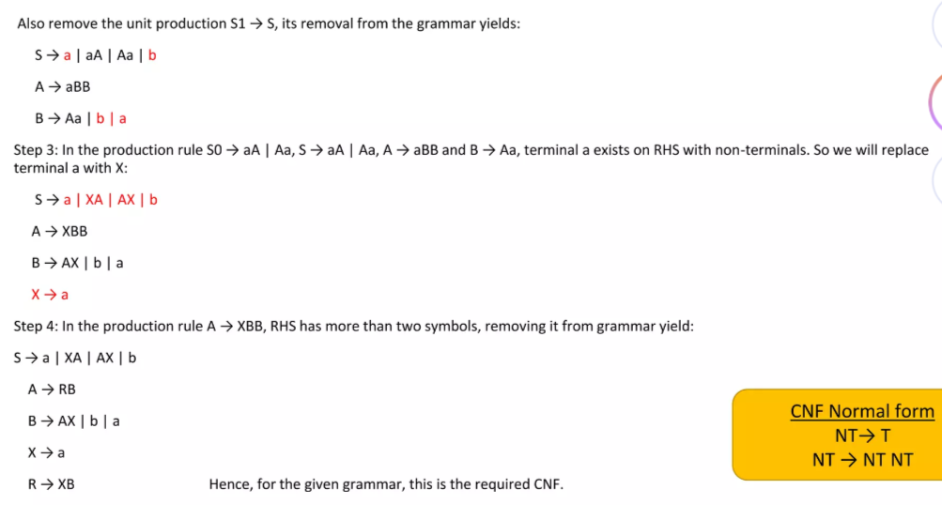
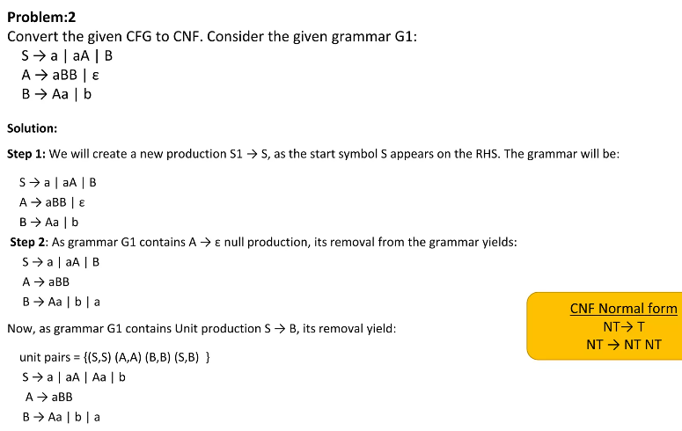

Slide 23
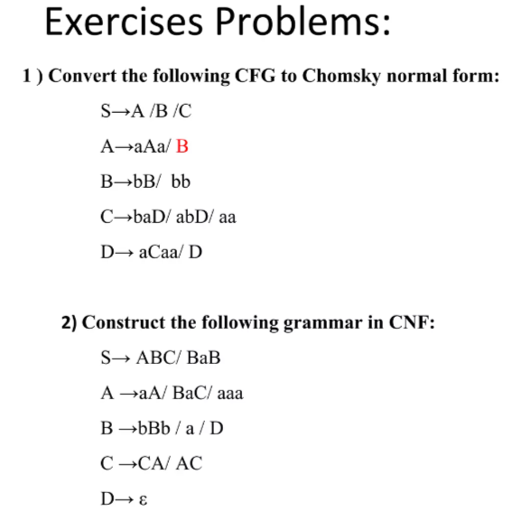
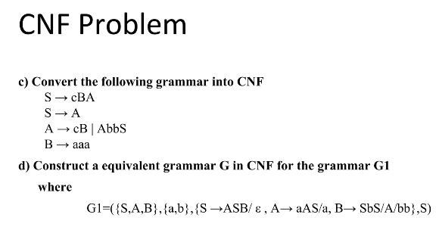

Slide 24
Closure Properties of Context Free Languages
Context-Free Languages (CFLs) form an important class of languages in automata theory and formal language theory. These languages are generated using context-free grammars (CFGs) and are recognized by pushdown automata (PDAs).
Context-Free Languages are generated by Context-Free Grammars (CFGs).
CFLs are accepted and recognized by Pushdown Automata (PDAs).
Closure properties explain whether applying an operation to CFLs results in another CFL.
CFLs are closed under some operations, meaning the result is always a CFL.
CFLs are not closed under certain operations, which may produce non-context-free languages.
A context-free grammar consists of production rules of the form A → α.
Properties of Context Free Languages
CFLs are closed under the following operations:
1. Union
If L and M are two context-free languages, then their union L ∪ M is also a CFL.

Slide 25
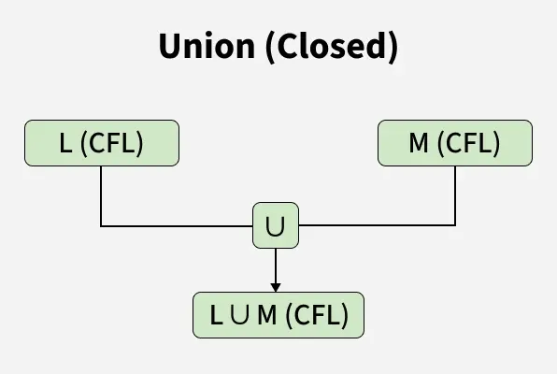
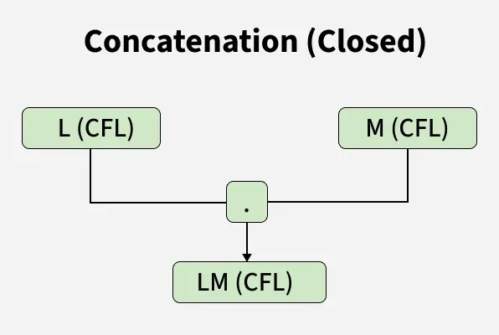
Construction:
Consider two context-free grammars, G and H, for L and M respectively.
Assume that G and H have no common variables (this can be ensured by renaming variables if needed).
Introduce a new start symbol S and add the rule: S → S₁ | S₂ Here, S₁ and S₂ are the start symbols of G and H, respectively.
The resulting grammar generates L ∪ M, proving that CFLs are closed under union.
2. Concatenation
If L and M are CFLs, then their concatenation LM is also a CFL.

Slide 26
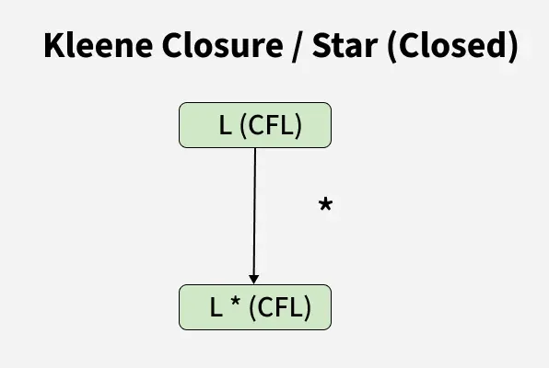
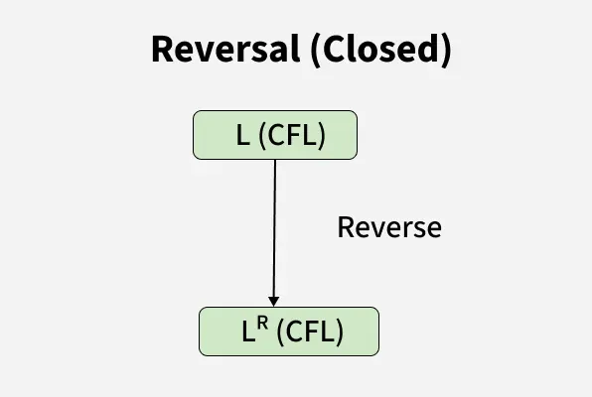
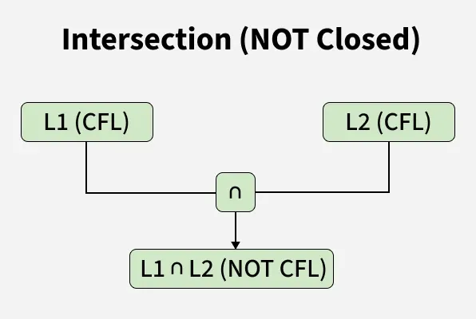
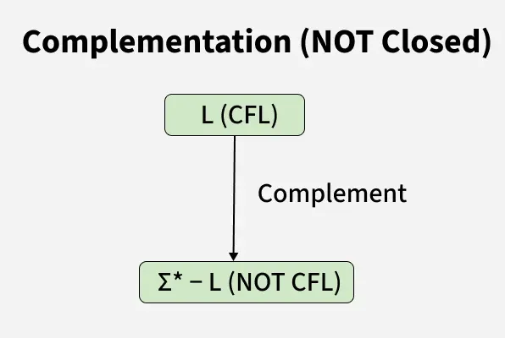
3. Kleene Closure
If L is a CFL, then its Kleene closure L* (zero or more repetitions of strings in L) is also a CFL.
5. Reversal: If L is a CFL, then its reversal L^R (where each string is reversed) is also a CFL.
Original Grammar: S → 0S1 | 01
Reversed Grammar: S → 1S0 | 10
4. Intersection and complementation
If L1 and If L2 are two context free languages, their intersection L1 ? L2 need not be context free.

Slide 27
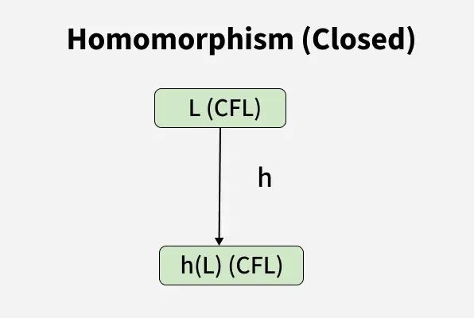
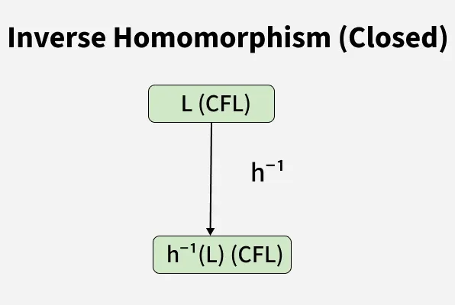
6. Homomorphism
A homomorphism is a function that replaces each symbol in a string with another string.
If L is a CFL and h is a homomorphism, then h(L) is also a CFL.
Let G have the production S → 0S1 | 01.
Define a homomorphism h(0) = ab, h(1) = ε.
Then, h(L(G)) will be generated by a new grammar with productions: S → abS | ab
7. Inverse Homomorphism
If L is a CFL and h is a homomorphism, then h⁻¹(L) is also a CFL.

Slide 28
Simplification of Context Free Grammars
A Context-Free Grammar (CFG) is a formal grammar that consists of a set of production rules used to generate strings in a language. However, many grammars contain redundant rules, unreachable symbols, or unnecessary complexities. Simplifying a CFG helps in reducing its size while preserving the generated language, making parsing more efficient.
Need for CFG simplification
Efficient Parsing: Smaller grammars require fewer computations.
Better Understanding: Removing redundant parts makes it easier to analyze.
Optimization: Improved computational efficiency in compilers and language processing.
Types of Redundant Productions and Their Removal
Types of redundant productions and the procedure of removing them are mentioned below:
1. Useless productions
The productions that can never take part in derivation of any string , are called useless productions. Similarly , a variable that can never take part in derivation of any string is called a useless variable

Slide 29
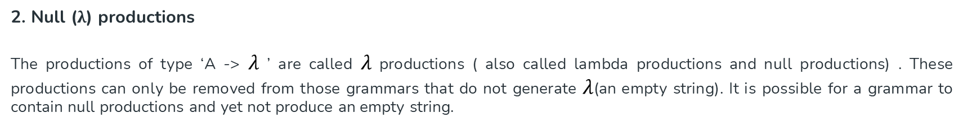
2. Null (λ) productions
The productions of type ‘A -> $λ$ ’ are called $λ$ productions ( also called lambda productions and null productions) . These productions can only be removed from those grammars that do not generate $λ$(an empty string). It is possible for a grammar to contain null productions and yet not produce an empty string.
3. Unit productions
The productions of type ‘A -> B’ are called unit productions.
Note: To remove all kinds of productions mentioned above, first remove the null productions, then the unit productions and finally , remove the useless productions. Following this order is very important to get the correct result.

Slide 30
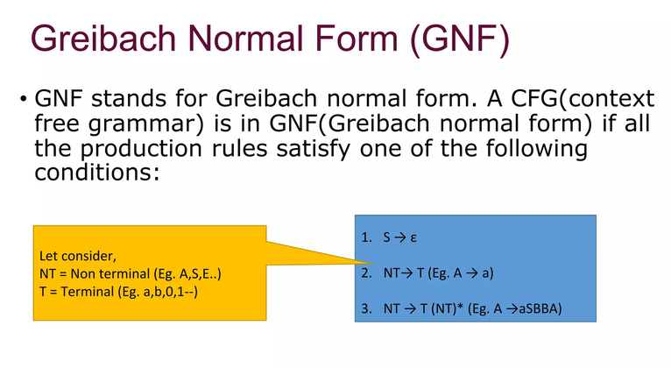

Slide 31
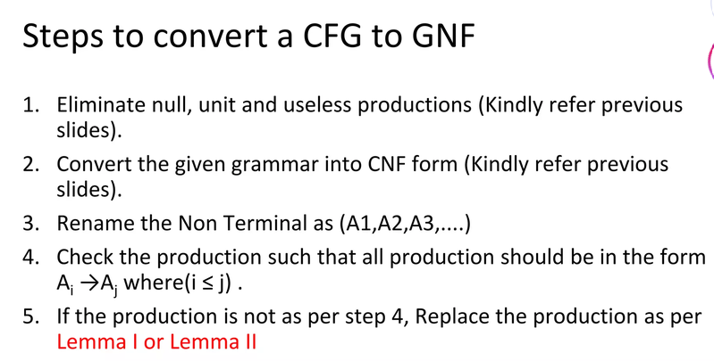

Slide 32
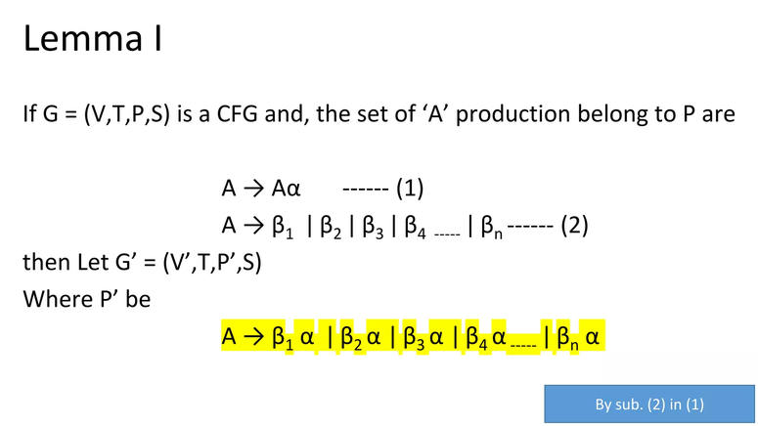

Slide 33
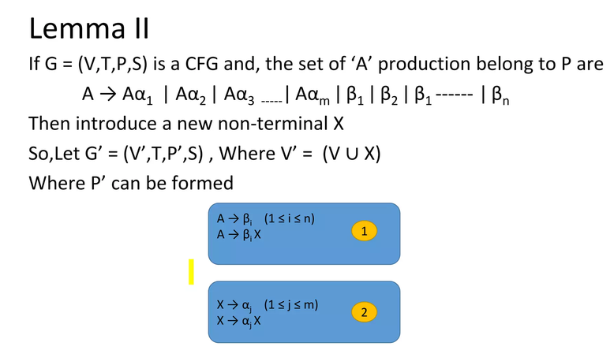

Slide 34
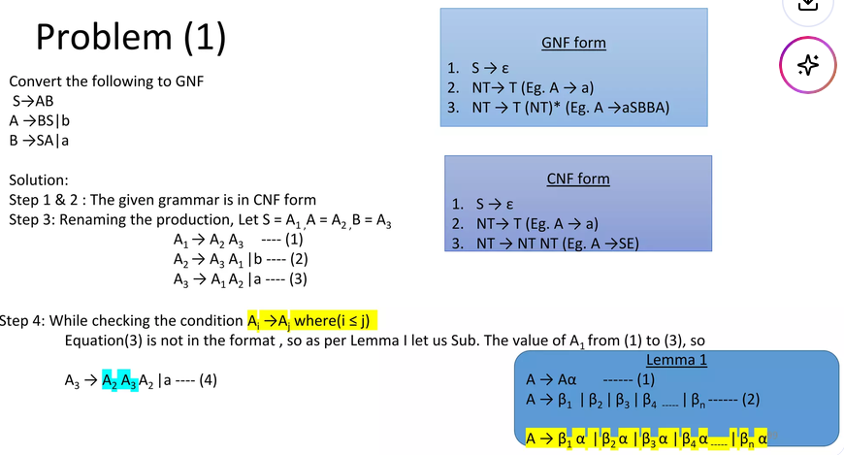

Slide 35


Slide 36


Slide 37


Slide 38


Slide 39


Slide 40


Slide 41


Slide 42


